Slide 1


Network protocols & security
24EC2210
Topic:
Routing Algorithms: Flooding, Shortest path
Session - 20

Slide 2
AIM OF THE SESSION
To familiarize students with the Static routing algorithms
INSTRUCTIONAL OBJECTIVES
This Session is designed to:
Describe the optimality principle of routing
Describe the routing process of Flooding algorithm
Explain the routing process of shortest path routing algorithm
LEARNING OUTCOMES
At the end of this session, you should be able to:
Compare static and dynamic routing.
Illustrate the working of Flooding algorithm.
Compute the shortest path using Dijkstra’s algorithm.

Slide 3
SESSION INTRODUCTION
The main function of the network layer is routing packets from the source machine to the destination machine. Packets will require multiple hops to make the journey.
Routing algorithm is part of the network layer software responsible for deciding which output line an incoming packet should be transmitted on.
Datagram network: Routing Decision must be made anew for every arriving data packet since the best route may have changed since last time.
Virtual circuit Network: Routing decisions are made only when a new virtual circuit is being set up. Thereafter, data packets just follow the already established route.
When a router receives a packet, it handles two processes:
1. Forwarding process- Looking up the outgoing line to use for it in the routing table.
2. Table Updating process- Responsible for filling in and updating the routing table.

Slide 4
Properties of Routing Algorithms…
Objective of routing algorithms is to calculate `good’ routes.
Regardless of whether routes are chosen independently for each packet sent(Datagrams) or only when new connections are established(Virtual Circuits), certain properties are desirable in a routing algorithm.
Correctness: The routing should be done properly and correctly so that the packets may reach their proper destination.
Simplicity: The routing should be done in a simple manner so that the overhead is as low as possible.
Robustness: The algorithms designed for routing should be robust enough to handle hardware and software failures and should be able to cope with changes in the topology and traffic.
Stability: The routing algorithms should be stable under all possible circumstances.
Fairness: Every node connected to the network should get a fair chance of transmitting their packets. This is generally done on a first come first serve basis.
Optimality: The routing algorithms should be optimal in terms of throughput and minimizing mean packet delays.

Slide 5
Types of Routing Algorithms
Routing algorithms can be grouped into two major classes:
Non-adaptive
Adaptive
Non-Adaptive:
Routing decisions does not depend on measurements or estimates of the current topology and traffic.
The route to travel from source to destination is computed in advance.
This procedure is sometimes called Static routing.
Adaptive algorithms:
Change their routing decisions to reflect changes in the topology, and sometimes changes in the traffic as well.
Known as Dynamic routing.

Slide 6
List of Routing Algorithms
The Optimality Principle
Flooding
Shortest Path Routing
Distance Vector Routing
Link State Routing
Hierarchical Routing
Broadcast Routing
Multicast Routing

Slide 7
The Optimality Principle
Optimality Principle states that
“ if router J is on the optimal path from router I to router K, then the optimal path from J to K also falls along the same route.”
Let us call the part of the route from I to J as r1 and the rest of the route as r2.
If a route better than r2 existed from J to K, it could be concatenated with r1 to improve the route from I to K, contradicting our statement that r1r2 is optimal.

Slide 8
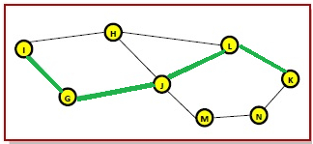
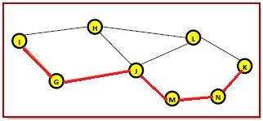
The Optimality principle Example…
Example
Consider a network of routers, {G, H, I, J, K, L, M, N} as shown in the figure. Let the optimal route from I to K be as shown via the green path, i.e. via the route I-G-J-L-K. According to the optimality principle, the optimal path from J to K with be along the same route, i.e. J-L-K.
Now, suppose we find a better route from J to K is found, say along J-M-N-K. Consequently, we will also need to update the optimal route from I to K as I-G-J-M-N-K. This new optimal path is shown as orange lines in the figure.

Slide 9
Flooding

Slide 10
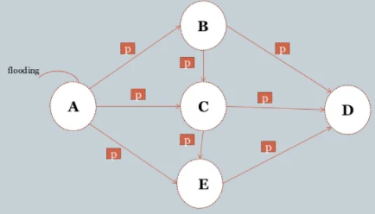
1. Flooding Algorithm
Requires no network information like topology, load condition, cost of different paths, etc.
Every incoming packet to a node is sent out on every outgoing line except the one it arrived on.
Limitations –
Flooding generates vast number of duplicate packets
Suitable damping mechanism must be used

Slide 11
Flooding…
Flooding obviously generates vast numbers of duplicate packets, in fact, an infinite number unless some measures are taken to damp the process. One such measure is to have a hop counter.
Hop:
A hop is a computer networking term that refers to the number of routers that a packet passes through from its source to its destination.
Hop-Count:
A hop counter may be contained in the packet header which is decremented at each hop.
The packet is discarded when the counter becomes zero.
Ideally, the hop counter should be initialized to the length of the path from source to destination.
If the sender does not know how long the path is, it can initialize the counter to the worst case, namely, the full diameter of the network.

Slide 12
Flooding…
Sequence Number:
Flooding with a hop count can produce an exponential number of duplicate packets as the hop count grows and routers duplicate packets they have seen before.
A better technique for damming the flood is to have routers keep track of which packets have been flooded, to avoid sending them out a second time.
One way to achieve this goal is to have the source router put a sequence number in each packet it receives from its hosts.
Each router then needs a list per source router telling which sequence numbers originating at that source have already been seen. If an incoming packet is on the list, it is not flooded.
Selective Flooding:
Routers do not send every incoming packet out on every line, only on those lines that go in approximately in the direction of the destination.

Slide 13
Shortest path routing

Slide 14
2. Shortest Path Routing Algorithm
A graph for the subnet is built with each node of the graph representing a router and each arc of the graph representing communication line.
The algorithm finds a shortest path from a node to all other nodes in the network.
Dijkstra’s algorithm is used for solving the problem.
Steps followed:
Dijkstra’s algorithm starts by assigning some initial values for the distance from node S to every other node in the network
At each step, the shortest distance from node S to another node is determined.

Slide 15
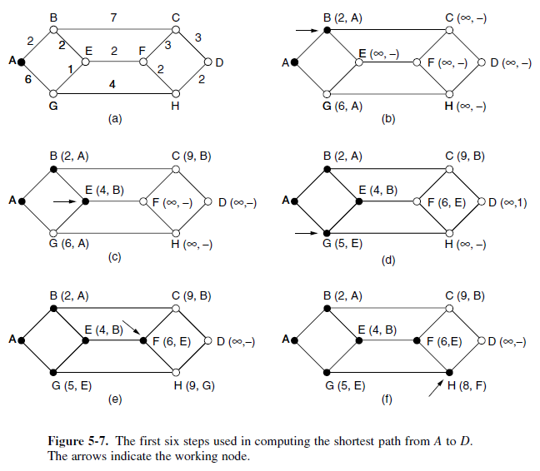

Slide 16
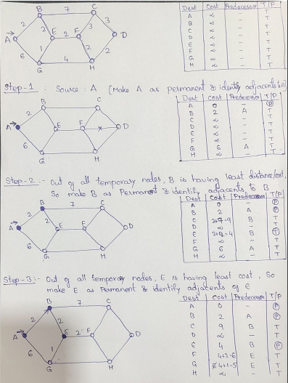

Slide 17
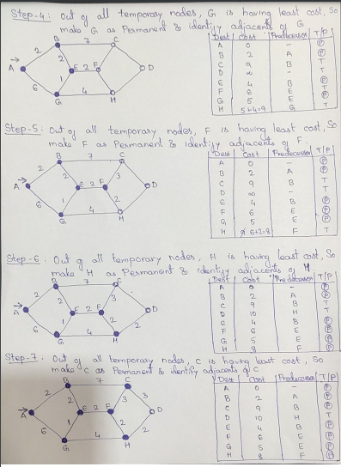

Slide 18
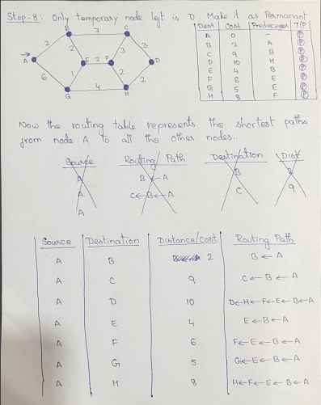

Slide 19

SUMMARY
Optimality Principle
Flooding algorithm
Shortest Path Routing algorithm

Slide 20
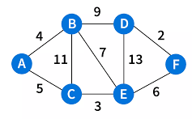
TERMINAL QUESTIONS
Compare adaptive and non-adaptive routing algorithms.
Define optimality principle with an example.
Illustrate the routing process of flooding algorithm.
Mention the drawback of flooding algorithm and explain the methods to overcome the drawback.
Consider the network given. Compute shortest path from node A to all other nodes.

Slide 21
REFERENCES FOR FURTHER LEARNING OF THE SESSION
Reference Books:
A.S. Tanenbaum, David J. Wetheral “Computer Networks” Pearson, 5th Edition.
Behrouz A. Forouzan , “Data Communication and Networking”, TMH, 5th Edition, 2012.
Web Links:
https://www.tutorialspoint.com/the-optimality-principle-in-computer-networks

Slide 22
THANK YOU
Team – Network Protocols & Security

